Slide 1

Fiber to the MDU Unit
The time is now!
Your Optical Fiber Solutions Partner®
All Rights Reserved, Copyright © OFS Fitel, LLC 2022

Slide 2
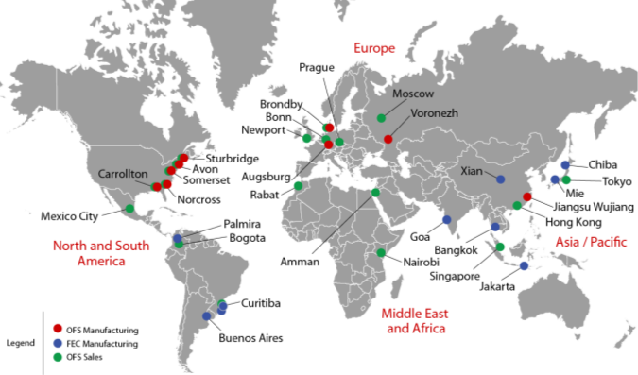
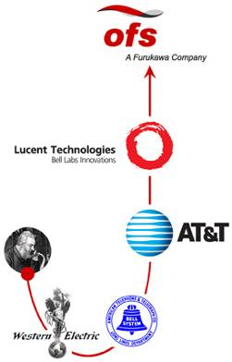
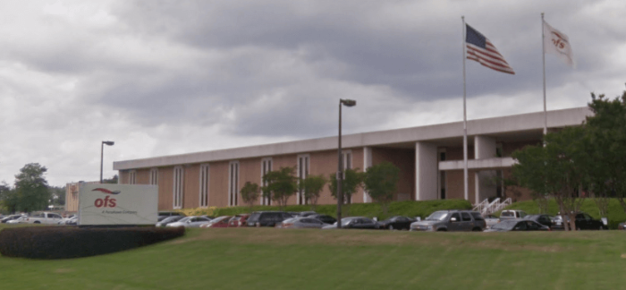
OFS – Reliable, Innovative, Global
OFS and Furukawa Global Reach

Slide 3
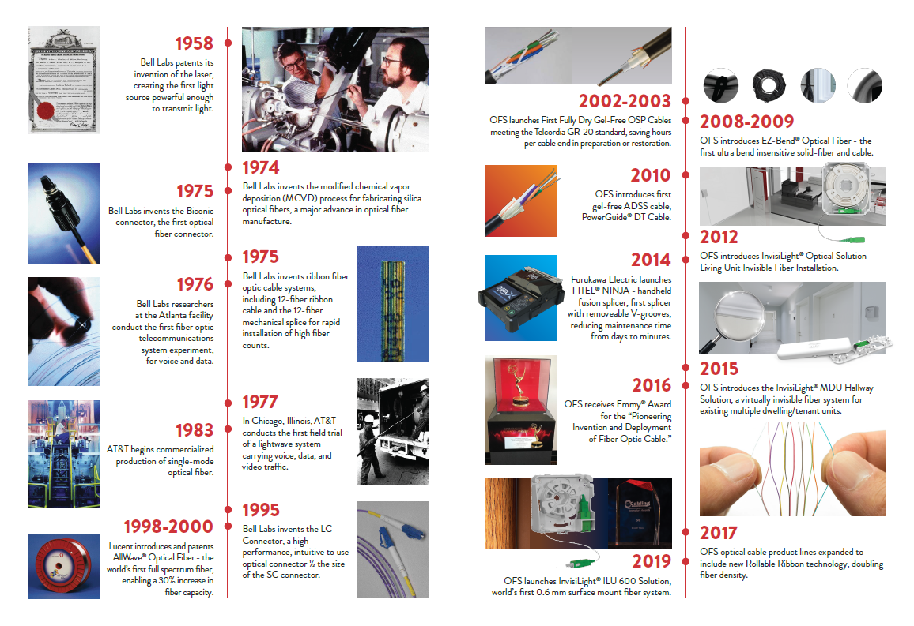
Bell Labs fiber heritage
3

Slide 4
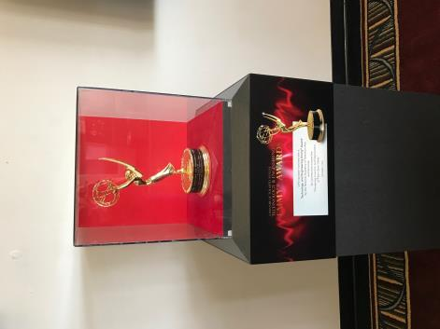
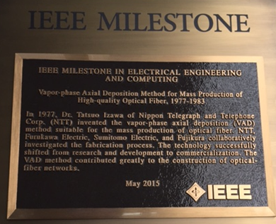
An original inventor of fiber
40+ year history in fiber technology
Technology Emmy Award winner, 2017
  “Pioneering Invention and Deployment of Fiber Optic Cable”
Fiber manufacturing method, IEEE Milestone Recipient
  <250 granted in the history of electricity
  Others include AC power, Maxwell’s equations, telephone, television, etc.
Hundreds of patents including the LC connector

Slide 5
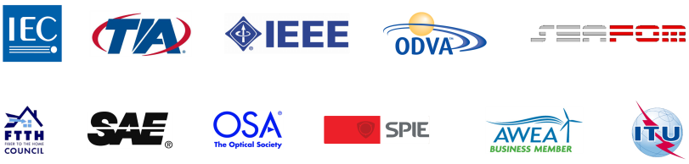

Industry Stewards
OFS takes seriously its leadership role as a steward
for industry change, viability, and innovation.
Our professional memberships show the breadth of this commitment:

Slide 6
MDUs first
Faster to install
Less expensive
Typically shorter lead times
Newer technology
More viable regulatory environment

Slide 7
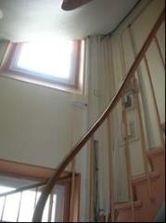
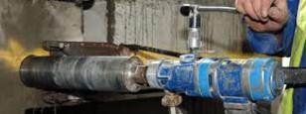
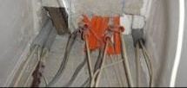
Fiber Pathway Challenges
Sometime no pathways, core drilling may be needed
Pathways may be restricted in size and/or be occupied
Building owners want installation completed quickly
Fiber must be hidden or inconspicuous
Core Drilling: loud, disruptive, and expensive (up to $1000s/building)
Older buildings may have no riser space
Existing duct, already occupied

Slide 8
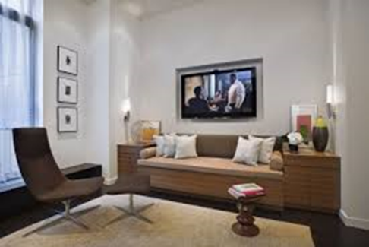
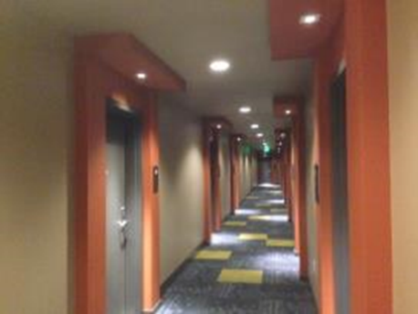
Fiber Pathway Challenges
Restricted / no pathways
Corners
Fiber terminal deep inside office or living unit
Quick and hidden installation desired
Surface mounting may be the only option

Slide 9
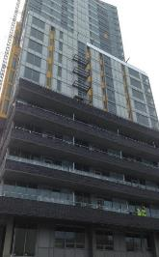

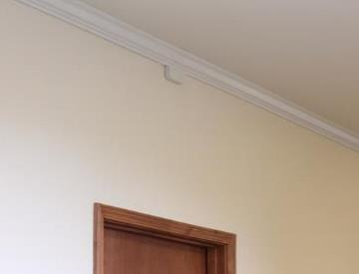
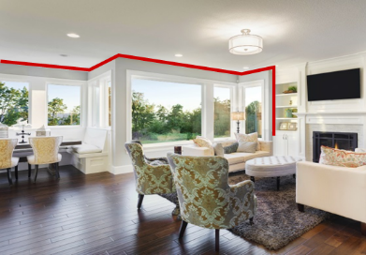


EZ Bend® and InvisiLight® Optical Solutions
EZ-Bend® Solutions
New and existing buildings
InvisiLight MDU and Facade Solutions
Existing buildings
InvisiLight ILU / Office Solution
Existing buildings
1 , 2, or 4 fibers to each unit
4 - 16 fibers in hallways
1 or 2 fibers inside the unit

Slide 10
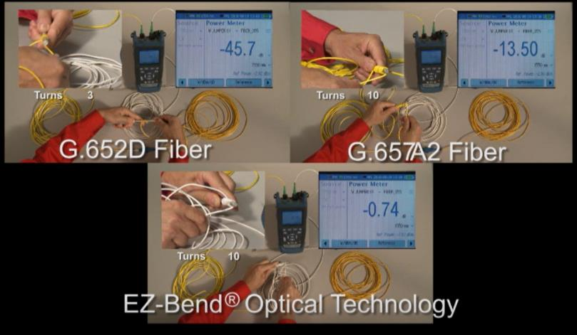
All of these use EZ Bend Fiber
Buildings have many corners
  Standard SMF will attenuate
EZ-Bend Fiber
  2.5 mm bend radius can handle any corner (and many corners) - best competitor is 5 mm
OFS Labs Patented Original Innovation – (Resonance Assisted Fiber)
Millions of homes/businesses already connected

Slide 11
Why EZ Bend Fiber
Optical Fiber Bending Loss Increase vs Wavelength
Macro-bending Loss of typical standard G.652D SMF
Single 360 degree turn (maximum loss)
20
15
10 mm radius
std SMF
Macrobending Loss (dB)
7.5 mm radius
10
std SMF
5
5 mm radius
std SMF
0
1260
1280
1300
1320
1340
1360
1380
1400
1420
1440
1460
1480
1500
1520
1540
1560
1580
1600
1620
Wavelength (nm)
Tighter bends and longer wavelengths mean more loss with traditional fibers

Slide 12
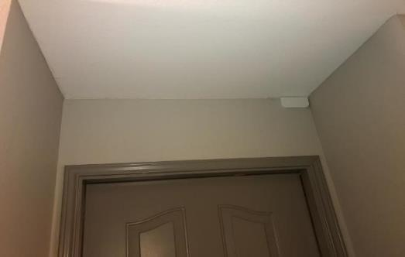
Why EZ Bend fiber?
30 mm
G.652.D Specification
G.652.D from OFS
G.657.A1
G.657.A2
G.657.B3
Diameter of Loop Loss Specification
16 mm
OFS EZ-Bend fiber
10 mm
7.5 mm
5 mm
2.5 mm

Slide 13
Why EZ Bend Fiber?
Application | Standard | Current Generation |  | Next Generation on Same Fiber Network |  | Bending Loss Increase
FTTH | IEEE | GE-PON downstream | 1490 nm | 10G E-PON downstream | 1577 nm | 3X
 | ITU-T | G-PON Downstream |  | 10G-PON (XGS) downstream
 |  |  |  | 40G-PON (NG-PON2) | 1603 nm | 4X
DOCSIS and HFC | SCTE /ITU | RF-Video downstream | 1550 nm | RFoG upstream | 1610 nm | 2X
Metro and some Long Haul | ITU | C-Band DWDM /CWDM | 1560 nm | L-Band DWDM /CWDM | 1625 nm | 2.5X
Next generation systems use longer wavelengths – more bend loss

Slide 14
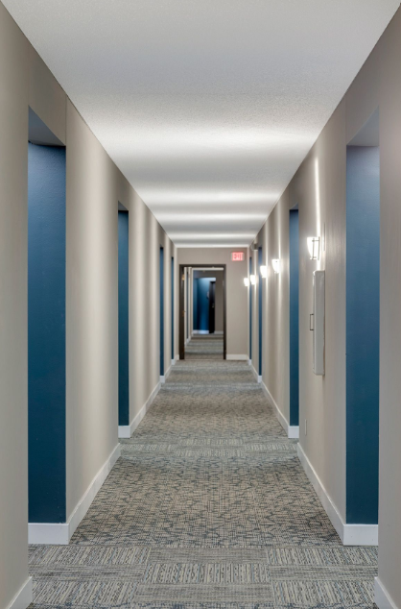
Drop applications in a hallway
Hallways have many 90° angles
Hallways with recessed doors may have 4 angles per door
Recessed Doors

Slide 15



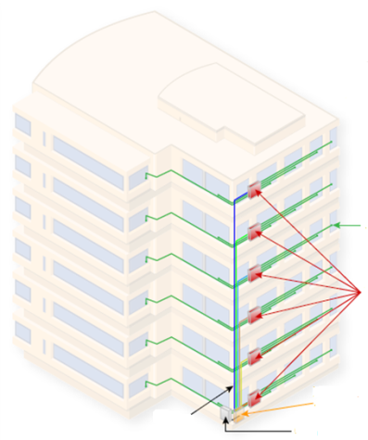













Building anatomy and technology choices
MDU Solutions – Mix and Match
Variables to consider
In Living Unit Options
InvisiLight ILU
EZ Bend (3.0/4.8)
SlimBox Wall Plate
Pathways
Residents
Cost
Available pathways
Aesthetics
Material Cost
Vertical and Horizontal Cabling Options (Outdoor)
EZ Bend Bundles
InvisiLight Facade
Time in building
Labor cost
Riser Space
Intermediate Connection and Splicing Devices (Optional)
SlimBox Rosette
SlimBox (Indoor) 12,24, 64 fibers
V-Linx Terminal (Up to 24 fibers)
V-Linx Combiner (Up to 72 fibers)
In Living Unit Cabling
Horizontal and Drop cabling
Vertical and/or Horizontal Cabling Options (Indoor)
EZ Bend (3.0/4.8)
InvisiLight MDU
HomeRun (Drop Ceilings)
Riser cabling options
Intermediate connection devices
Fiber Distribution Devices (with or without splitters, with or without adapters)
SlimBox (Indoor) 12,24, 64 fibers
SlimBox (Outdoor)
12,24, 48 fibers
400A (Indoor)
Up to 64 fibers
V-Linx FDH,(Indoor) Up to 144 fibers
Fiber Distribution Devices (indoors or outdoors)
Riser/Vertical Cabling Options

Slide 16
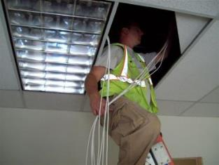

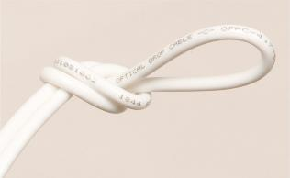
EZ-Bend® cable - Ruggedized 4.8 and 3 mm cords
4.8 mm
Available black or white
4.8 mm black available with toning wire
  Can be direct buried
Riser (OFNR) / FT-4, Plenum (OFNP) / FT-6
  Indoor / Outdoor Rated
Available in a box or as assemblies
  Factory terminated up to 300 ft lengths
  SC Connectors for 4.8 mm and 3 mm
  SC or LC connectors for 3 mm
3.0 mm
4.8 mm

Slide 17
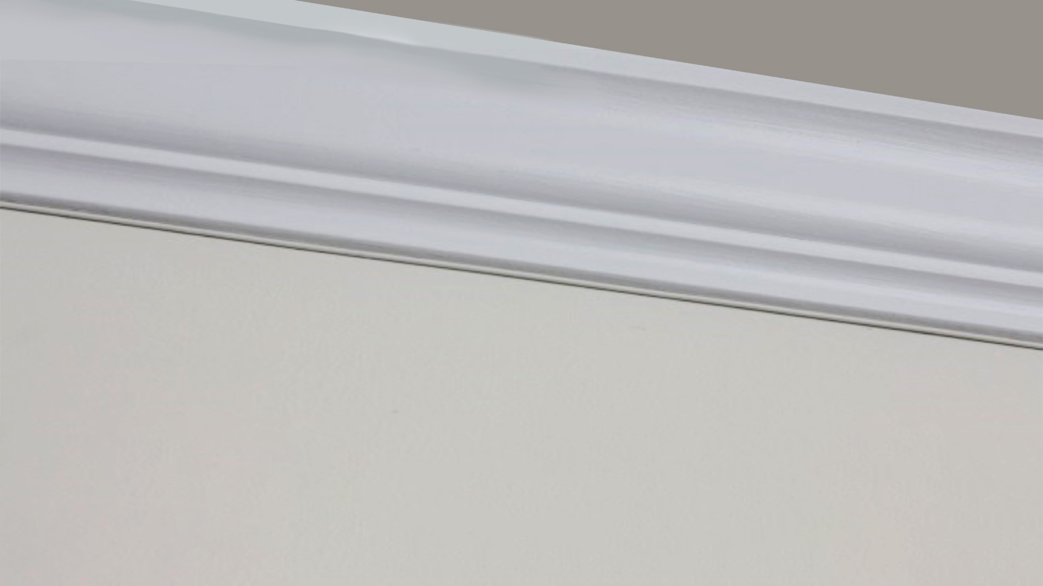

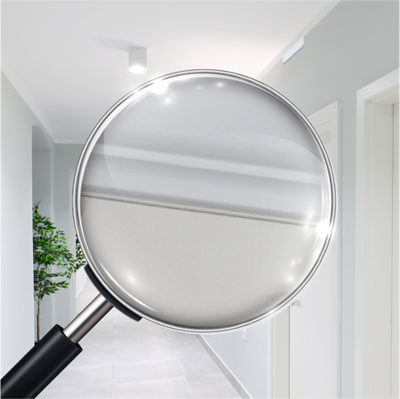

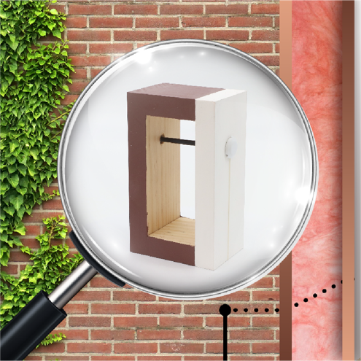
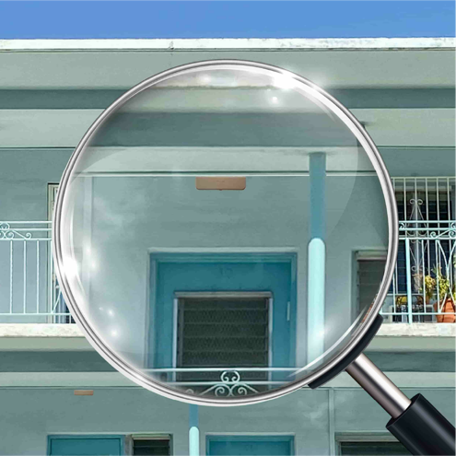

NOT SEEING IS BELIEVING.
Discrete and easily installable solutions for buildings and homes
with the InvisiLight® MDU, ILU, Drop, and Facade Solutions
MDU
ILU
Drop
Facade
Your Optical Fiber Solutions Partner®
Copyright © 2022 OFS Fitel, LLC. All Rights Reserved.

Slide 18
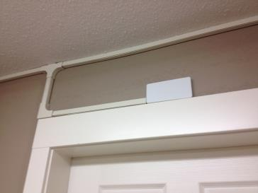
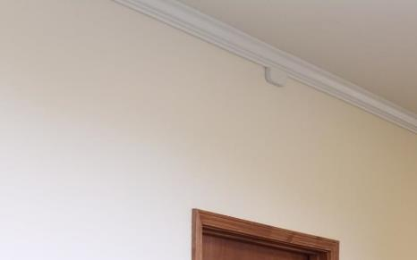
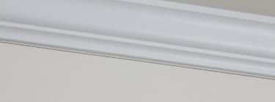
InvisiLight ® MDU Solution for hallways and risers
Conventional Hallway Fiber
InvisiLight MDU Solution
Molding
InvisiLight
12 fiber cord
Very visible
Disrupts Décor
Slow installation
Virtually invisible
Preferred by building owners and tenants vs. molding.
Faster and easier to install
$50 to $100 lower cost per door passed vs. molding systems.

Slide 19
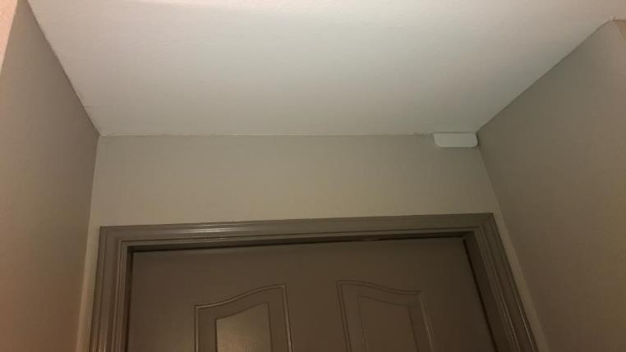
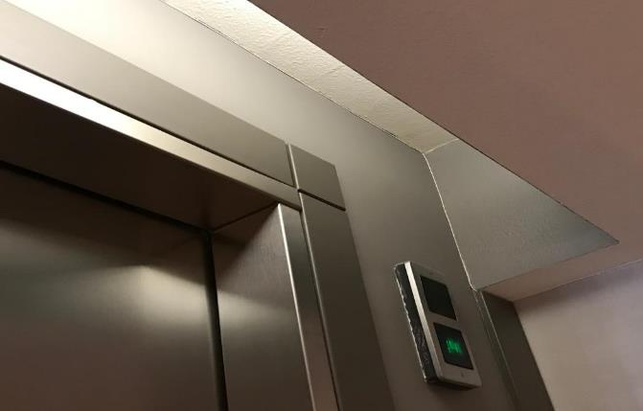
InvisiLight® MDU 12 fiber hallway installation

Slide 20
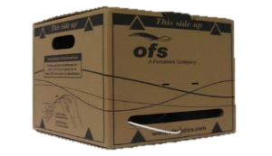
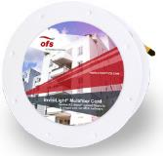

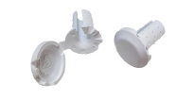



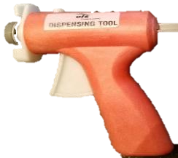
InvisiLight® MDU Solution – System Components
Bulk 2mm Cord,
12 fibers
Reel in Box (RIB)
2,000ft (610m)
Factory Terminated
2mm Cord,
12 fibers
MPO, SC, or LC
or
Hole Plug and Cap
Point of Entry (POE) module
Adhesive Tool and Adhesive Tubes Ordered Separately
Connector pull-through tool
(attaches to “fish stick”

Slide 21
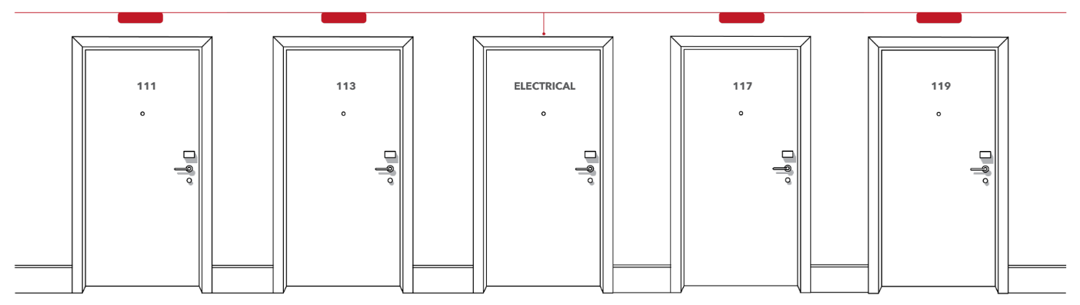

Slide 22




Installation technique – down the hallway

Slide 23

Installation technique – unconnectorized

Slide 24
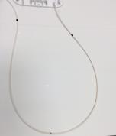
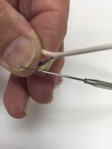
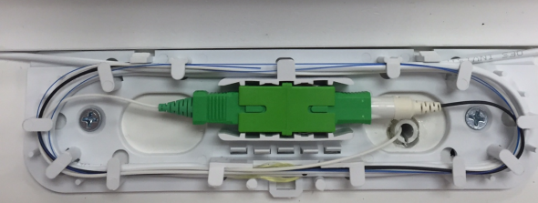
Adding a subscriber
Mark the cord (while in the POE module)
Slit jacket in 2 places with Jonard access tool
Cut and pull back the fiber
Add connector, groom, plug in

Slide 25
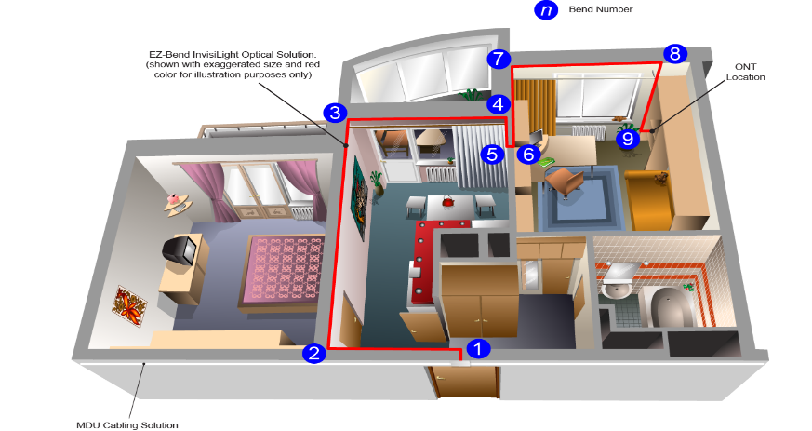
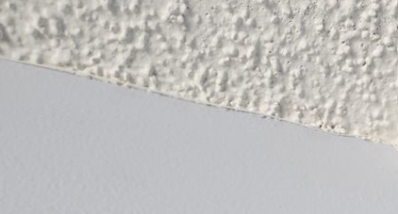
InvisiLight® Indoor Living Unit (ILU) and in-Office Solution

Slide 26
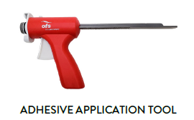
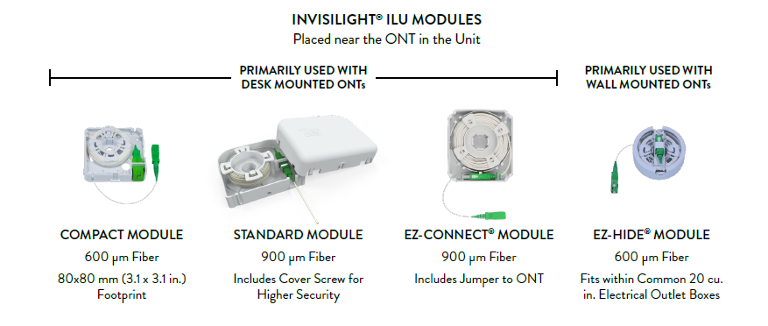
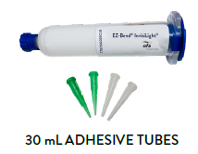
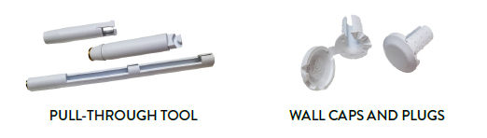
InvisiLight® ILU – System Components
26

Slide 27
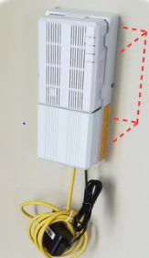
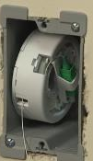
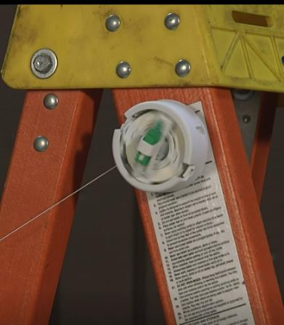
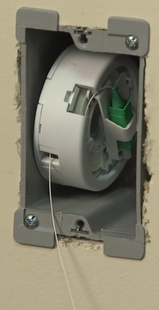
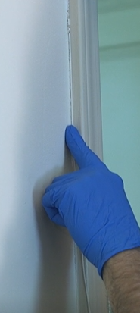
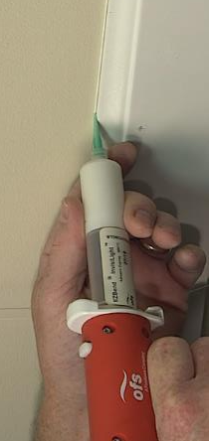


EZ Hide – Primarily for wall-mounted ONTs

Slide 28


SlimBox 64
Starting point for many in-building networks
Uses DirectConnect splitters
InvisiLight MDU/Façade part numbers optimized for use with SlimBox 64 FDH
  Breakout lengths
  Upjacketing

Slide 29


Examples

Slide 30



Slide 31



Slide 32






InvisiLight® Whole Building Installation - 4 floors 60 units
Point of entry module - from hallway to each unit or office
Service Provider will later plug EZ-Bend ® jumper to optical modem from this point

Slide 33
Case Study – 48 unit building

Slide 34

Initial installation – InvisiLight MDU
4 floor building – 48 customers
Wired from FDH to ONT in approximately 3-4 days
  InvisiLight ILU in units
  InvisiLight MDU in risers and hallways
Building owner pleased
Optically tested fine

Slide 35
Survey math
180’
6’
Hallway
Telecom and electrical closet
12’
40’ up riser (for longest length)
360’ down hallway (2x)
48’ 4’ slack in 12 point of entry modules
12’ ends of hallway
15’ in closet
15’ extra
490’ (150m) Total
155m lengths ordered…no length issues
FDH

Slide 36


Tools used – complete list in installation documents
Removable clips, glasses, headlamp, scissors
Skewers for fiber access

Slide 37




Beginning of process
Place point of entry modules
Completely unspool from FDH location
Plug in later
With firestop and InvisiLight ILU added
Cord coming out from riser in telecom closet

Slide 38







Additional prep work if needed
Inside and outside bend limiters at corners
Through wall tool and wall plugs/caps
3/8” (10mm)
Hole drilled outside of telecom closet. Tape eventually removed

Slide 39


Use clips to hang cord above each doorway
Repositionable clips
Clip applied, slack is good

Slide 40


Cord pulling and takeup
Cord is very light weight
Cord should have very little tension even over long distances
Stop pull and look for obstacles if significant tension is felt
Concern is more for fiber crushing than excess tension
Take up on empty spool using broomstick and box

Slide 41

Wheels can be very helpful
Wheeled scaffolding is very effective
  Speeds up adhesive and cord placement processes
  Smooths out adhesive installation process
Painter’s tape before and after POE and around corners can be helpful to speed installation

Slide 42


Adhesive process – pictures not from the trial
Apply very thin adhesive bead…thinner is better!!
Apply long stretch to allow it to turn tacky (<10-15 minutes, typical)
Keep a wet rag handy to remove excess!
Press cord into adhesive with finger

Slide 43

Adhesive process
Thinner bead is better
Expect 65-100’ (20-30 m) per tube
Installers typically use less as experience grows
OFS testing shows approximately 100’ (30m)/tube

Slide 44



Adhesive and loops
Adding adhesive and loops
Keep cordage slack enough to pull back and make 3 wraps inside module
Finished module with 3 wraps of cord

Slide 45



Connecting a customer
Slit here
Slit here
Make a mark on all wraps at the bottom of the module
Remove cord from module

Slide 46



Slit cord at marked locations
Cut fiber at slit farthest from FDH
Pull back fiber from other slit
Slit cord with Jonard tool at two outside marks (1/2-1” (12-25 mm) working inward

Slide 47




Add connector, mark ID, groom, close

Slide 48


Fusion splice-on connector process
4 loops used inside Point of Entry module
  Enabled enough length to splice on top of ladder
After connector added, groom cord
Add fiber and connector last

Slide 49


The finished hallway – where’s the fiber?

Slide 50



Additional pictures

Slide 51



Slide 52


Additional pictures from properties

Slide 53



Slide 54



Slide 55

InvisiLight Facade
What is it?
  Cord and installation system for vertical or horizontal outdoor deployments
    12 fibers - 3.0 mm
    24 fibers – 3.8 mm
  Ultra bend-insensitive optical fiber for very tight indoor bends
    Meets Telcordia GR-326 and GR-1435 standards
  Materials compliant with flammability/smoke regulations
    UL Riser/FT-4 rating

Slide 56







System components – InvisiLight Facade
Bare or Preconnectorized Indoor/Outdoor Multifiber Cord – 12F, 24F
Point of entry modules with connector adapter
Fasten with “Shark’s Tooth” cable clip model BT187SK100 or similar. (Not purchased from OFS).

Slide 57


Sample pictures, InvisiLight Facade

Slide 58



Slide 59






Different configuration
InvisiLight Façade Cord
4 fiber SlimBox
EZ Bend to each unit
In unit to ONT
Field installable connector
Wall plate (optional)

Slide 60




InvisiLight® Façade Solution
Cords in Molding
InvisiLight® Façade Installation
InvisiLight® Façade Bulk Cord,
Fibers 3mm OD
24 Fibers 3.8 mm OD
Reel in Box (RIB)
Rejected by MDU Property
Accepted by MDU Property
$10 - $20 saving per apartment vs. molding+cords
InvisiLight®
24 Fiber Cord
Slimbox® Enclosure on Façade or in attic

Slide 61




InvisiLight® Façade/Breezeway Applications
12 and 24 Fiber Façade Cables
with EZ-Bend® Fiber
UV Resistant Compact POE

Slide 62



4 buildings, 8 units/each, 4 units upstairs, 4 units downstairs

Slide 63

Fiber layout
Second floor
8 units per building, 12 fiber cord
Complicated layout
45 90 degree angles, splitter to ONT
0.5 dB total loss from splitter to ONT including 2 splices and 2 connection points
Customer was very pleased
Horizontal path
First floor
Vertical path

Slide 64


Downstairs

Slide 65


Stairwells

Slide 66


Upstairs

Slide 67


Unit 103 – InvisiLight ILU
600 micron InvisiLight was completely invisible
Some problems unspooling fiber
InvisiLight is almost completely invisible on that surface

Slide 68





General recommendations – outdoor MDU pathways
Smaller buildings and garden style apartments
EZ Bend (3.0/4.8)
Spliced or pre-connectorized available
InvisiLight Facade
EZ Bend Bundles
Typically pre-connectorized on subscriber end
Mid-size and larger buildings

Slide 69





General recommendations – indoor MDU pathways
Smaller buildings and garden style apartments
EZ Bend (3.0/4.8)
Spliced or pre-connectorized available
InvisiLight MDU
For wall surface mount applications
Mid-size and larger buildings
HomeRun (Drop Ceilings)
For drop ceiling applications
When to use intermediate connection devices
SlimBox (Indoor) 12,24, 64 fibers
V-Linx Terminal (Up to 24 fibers)
V-Linx Combiner (Up to 72 fibers)
When riser space is limited
Reduce cords/cables in a riser (8-10 is typical max)

Slide 70

FTTx and In Building Solutions for the Entire Passive Network
http://www.ofsoptics.com/fttx-solution-offering.html

